Slide 1









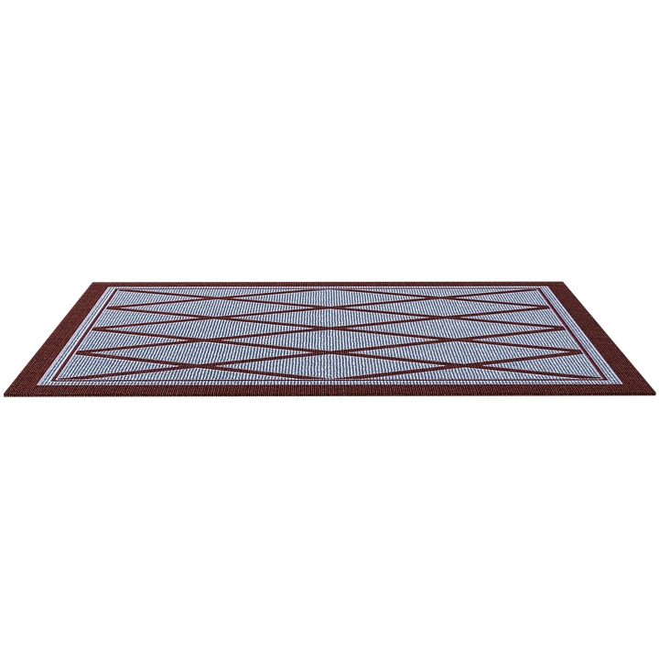









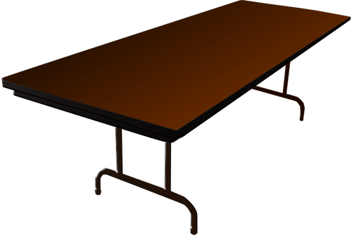



Mrs. M. Davis’ Class
Welcome Back Students !!!
Teacher Intro
View Syllabus/Class Rules

